Slide 1
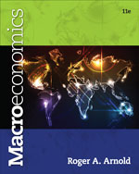
Chapter 13: The Federal Reserve System
© 2014 Cengage Learning. All Rights Reserved. May not be copied, scanned, or duplicated, in whole or in part, except for use as permitted in a license distributed with certain product , service, or otherwise on password-protected website for classroom use

Slide 2

In This Lecture…..
The Federal Reserve System
Controlling the Money Supply
Open Market Operations
The Required Reserve Ratio
The Discount Rate and Overnight Loans
The Federal Funds Rate Target
To select a topic, click on its link above
© 2014 Cengage Learning. All Rights Reserved. May not be copied, scanned, or duplicated, in whole or in part, except for use as permitted in a license distributed with certain product , service, or otherwise on password-protected website for classroom use

Slide 3
Structure of the Fed
Board of Governors - The governing body of the Federal Reserve System.
Federal Open Market Committee (FOMC) -The 12-member policymaking group within the Fed. The committee has the authority to conduct open market operations.
Open Market Operations - The buying and selling of government securities by the Fed.
To view a presentation on the Fed click the picture of Fed Headquarters – select “Structure Tour”
Click to return to “In this Lesson”
© 2014 Cengage Learning. All Rights Reserved. May not be copied, scanned, or duplicated, in whole or in part, except for use as permitted in a license distributed with certain product , service, or otherwise on password-protected website for classroom use

Slide 4
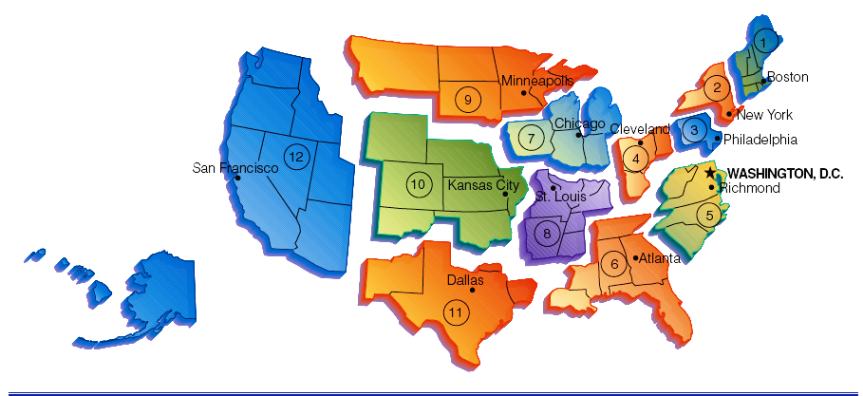
Federal Reserve Districts and Federal Reserve Bank Locations
Click to return to “In this Lesson”
© 2014 Cengage Learning. All Rights Reserved. May not be copied, scanned, or duplicated, in whole or in part, except for use as permitted in a license distributed with certain product , service, or otherwise on password-protected website for classroom use

Slide 5
Board of Governors
Board of Governors coordinates and controls the activities of the Federal Reserve System.
The board members serve 14-year terms and are appointed by the President with Senate approval.
To limit political influence on Fed policy, the terms of the governors are staggered—with one new appointment every other year—so a president cannot “pack” the board.
The President also designates one member as chairman of the board for a 4-year term.
Click to return to “In this Lesson”
© 2014 Cengage Learning. All Rights Reserved. May not be copied, scanned, or duplicated, in whole or in part, except for use as permitted in a license distributed with certain product , service, or otherwise on password-protected website for classroom use

Slide 6
Federal Open Market Committee I
The Federal Open Market Committee (FOMC) is the major policymaking group within the Fed.
Authority to conduct open market operations—the buying and selling of government securities—rests with the FOMC.
The FOMC has 12 members: the 7-member Board of Governors and 5 Federal Reserve District Bank presidents.
Click to return to “In this Lesson”
© 2014 Cengage Learning. All Rights Reserved. May not be copied, scanned, or duplicated, in whole or in part, except for use as permitted in a license distributed with certain product , service, or otherwise on password-protected website for classroom use

Slide 7
Federal Open Market Committee II
The president of the Federal Reserve Bank of New York holds a permanent seat on the FOMC because a large amount of financial activity takes place in New York City and because the New York Fed is responsible for executing open market operations.
The other four positions are rotated among the Federal Reserve District Bank presidents.
Click to return to “In this Lesson”
© 2014 Cengage Learning. All Rights Reserved. May not be copied, scanned, or duplicated, in whole or in part, except for use as permitted in a license distributed with certain product , service, or otherwise on password-protected website for classroom use

Slide 8
Monetary Policy
Changes in the money supply, or in the rate of change of the money supply, to achieve particular macroeconomic goals.
President Wilson signs the Federal Reserve Act on December 23, 1913.
Click to return to “In this Lesson”
© 2014 Cengage Learning. All Rights Reserved. May not be copied, scanned, or duplicated, in whole or in part, except for use as permitted in a license distributed with certain product , service, or otherwise on password-protected website for classroom use

Slide 9
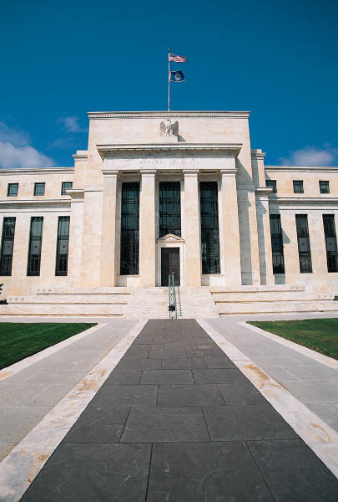
Federal Reserve Video
To view a short flash video on the functions of the Federal Reserve, click above. (Play at 150% browser setting)
Click to return to “In this Lesson”
© 2014 Cengage Learning. All Rights Reserved. May not be copied, scanned, or duplicated, in whole or in part, except for use as permitted in a license distributed with certain product , service, or otherwise on password-protected website for classroom use

Slide 10
Functions of the Fed
Control the money supply
Supply the economy with paper money (Federal Reserve notes)
Provide check clearing services
Hold depository institutions’ reserves
Supervise member banks
Serve as the government’s banker
Serve as the lender of last resort
Handle the sale of U.S Treasury Securities (Bills, notes, and bonds)
Click to return to “In this Lesson”
© 2014 Cengage Learning. All Rights Reserved. May not be copied, scanned, or duplicated, in whole or in part, except for use as permitted in a license distributed with certain product , service, or otherwise on password-protected website for classroom use

Slide 11
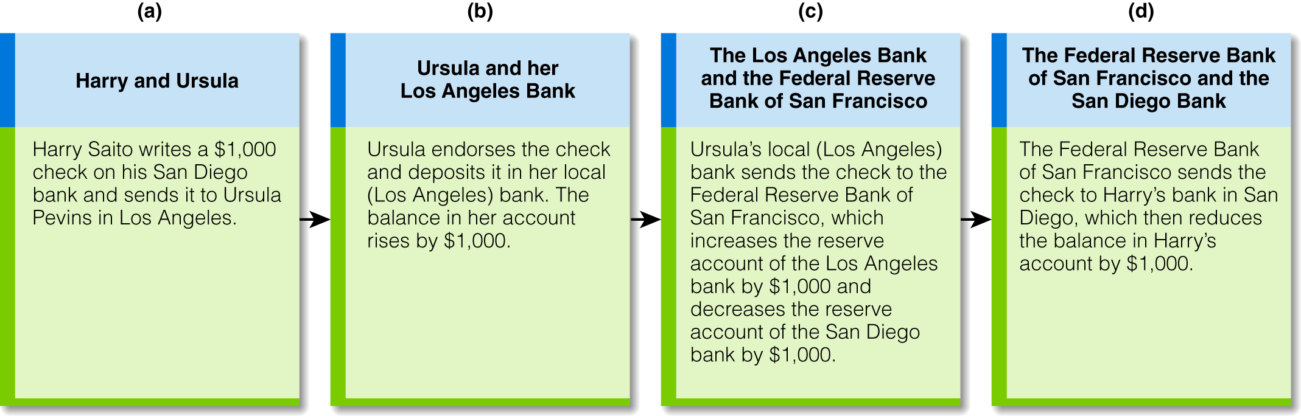
The Check Clearing Process
Click to return to “In this Lesson”
© 2014 Cengage Learning. All Rights Reserved. May not be copied, scanned, or duplicated, in whole or in part, except for use as permitted in a license distributed with certain product , service, or otherwise on password-protected website for classroom use

Slide 12
Fed vs. U.S. Treasury
The U.S. Treasury is a budgetary agency; the Fed is a monetary agency.
When the federal government spends funds, the Treasury collects the taxes and borrows the funds needed to pay suppliers and others. In short, the Treasury has an obligation to manage the financial affairs of the federal government. Except for coins, the Treasury does not issue money. It cannot create money out of thin air as the Fed can.
The Fed is principally concerned with the availability of money and credit for the entire economy. It does not issue Treasury securities. It does not have an obligation to meet the financial needs of the federal government. Its responsibility is to provide a stable monetary framework for the economy.
Click to return to “In this Lesson”
© 2014 Cengage Learning. All Rights Reserved. May not be copied, scanned, or duplicated, in whole or in part, except for use as permitted in a license distributed with certain product , service, or otherwise on password-protected website for classroom use

Slide 13
Self-test
The president of which Federal Reserve District Bank holds a permanent seat on the Federal Open Market Committee (FOMC)?
Federal Reserve Bank of New York.
Click to return to “In this Lesson”
© 2014 Cengage Learning. All Rights Reserved. May not be copied, scanned, or duplicated, in whole or in part, except for use as permitted in a license distributed with certain product , service, or otherwise on password-protected website for classroom use

Slide 14
Self-test
2. What is the most important responsibility of the Fed?
The Fed controls the money supply.
Click to return to “In this Lesson”
© 2014 Cengage Learning. All Rights Reserved. May not be copied, scanned, or duplicated, in whole or in part, except for use as permitted in a license distributed with certain product , service, or otherwise on password-protected website for classroom use

Slide 15
Self-test
3. What does it mean to say the Fed acts as “lender of last resort”?
Acting as the lender of last resort means the Fed stands ready to lend funds to banks that are suffering cash management, or liquidity, problems.
Click to return to “In this Lesson”
© 2014 Cengage Learning. All Rights Reserved. May not be copied, scanned, or duplicated, in whole or in part, except for use as permitted in a license distributed with certain product , service, or otherwise on password-protected website for classroom use

Slide 16
Review of Reserves, Required Reserves, and Excess Reserves
1. A bank’s reserves equal its bank deposits at the Fed (the balance in its reserve account at the Fed) plus its vault cash.
Reserves = Bank deposits at the Fed + Vault cash
2. A bank’s required reserves are equal to the required reserve ratio (r) times its checkable deposits.
Required reserves = r x Checkable deposits
3. A bank’s excess reserves equal its reserves minus its required reserves.
Excess reserves = Reserves - Required reserves
4. A bank can use its excess reserves to create new loans.
Click to return to “In this Lesson”
© 2014 Cengage Learning. All Rights Reserved. May not be copied, scanned, or duplicated, in whole or in part, except for use as permitted in a license distributed with certain product , service, or otherwise on password-protected website for classroom use

Slide 17

Tools for Increasing and Decreasing the Money Supply
Open Market Operations
Required Reserve Ratio
Discount Rate
To visit the Fed’s web site, click above.
Click to return to “In this Lesson”
© 2014 Cengage Learning. All Rights Reserved. May not be copied, scanned, or duplicated, in whole or in part, except for use as permitted in a license distributed with certain product , service, or otherwise on password-protected website for classroom use

Slide 18
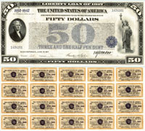
Open Market Operations
Open Market Purchase - The buying of U.S. government securities by the Fed
Open Market Sale - The selling of U.S. government securities by the Fed
Click to return to “In this Lesson”
© 2014 Cengage Learning. All Rights Reserved. May not be copied, scanned, or duplicated, in whole or in part, except for use as permitted in a license distributed with certain product , service, or otherwise on password-protected website for classroom use

Slide 19
T – Account
A Reminder
A simplified balance sheet that shows the changes in a bank’s assets and liabilities.
Click to return to “In this Lesson”
© 2014 Cengage Learning. All Rights Reserved. May not be copied, scanned, or duplicated, in whole or in part, except for use as permitted in a license distributed with certain product , service, or otherwise on password-protected website for classroom use

Slide 20
Money Supply Creation Process I
We start with the definition of the M1 money supply:
M1 = Currency held outside banks + Checkable deposits + Traveler’s checks
Let’s suppose that checkable deposits are $10,000 and that the other two components of the money supply equal $0. It follows that the money supply is $10,000.
Money supply = $10,000
Click to return to “In this Lesson”
© 2014 Cengage Learning. All Rights Reserved. May not be copied, scanned, or duplicated, in whole or in part, except for use as permitted in a license distributed with certain product , service, or otherwise on password-protected website for classroom use

Slide 21
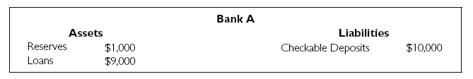
Money Supply Creation Process II
For now we are going to assume that the entire $10,000 in checkable deposits is held in one bank: bank A.
We will also assume that the required reserve ratio is 10 percent and that bank A is currently holding $1,000 in required reserves and no excess reserves. Here is the relevant part of the balance sheet for bank A:
Click to return to “In this Lesson”
© 2014 Cengage Learning. All Rights Reserved. May not be copied, scanned, or duplicated, in whole or in part, except for use as permitted in a license distributed with certain product , service, or otherwise on password-protected website for classroom use

Slide 22
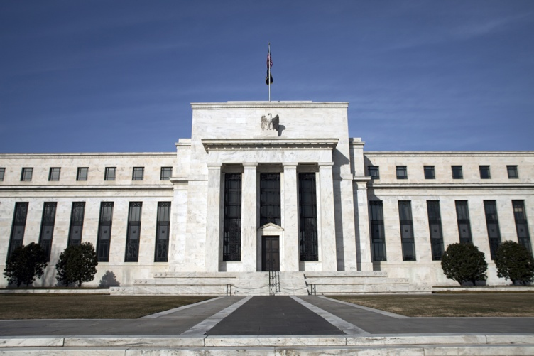
Money Supply Creation Process III
The Fed conducts an open market purchase, which is a type of open market operation; specifically, it buys government securities from a bank.
In this example it buys $500 worth of government securities from bank A. Bank A turns over the government securities to the Fed, and, in return, the Fed must pay bank A $500.
Click to return to “In this Lesson”
© 2014 Cengage Learning. All Rights Reserved. May not be copied, scanned, or duplicated, in whole or in part, except for use as permitted in a license distributed with certain product , service, or otherwise on password-protected website for classroom use

Slide 23
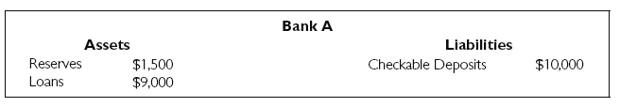
Money Supply Creation Process IV
The balance sheet for bank A shows $1,500 in reserves and $10,000 in checkable deposits. If the required reserve ratio is 10 percent, bank A is required to hold only $1,000 in reserves. So bank A has $500 in excess reserves.
Suppose bank A takes the entire $500 in excess reserves and creates a loan for Jill. Specifically, it grants Jill a $500 loan in the form of a new checkable deposit with a balance of $500. In other words, instead of giving Jill $500 in currency, bank A simply tells Jill that she now has a checkable deposit (a checking account) with the bank and that the balance in the account is $500.
.
Click to return to “In this Lesson”
© 2014 Cengage Learning. All Rights Reserved. May not be copied, scanned, or duplicated, in whole or in part, except for use as permitted in a license distributed with certain product , service, or otherwise on password-protected website for classroom use

Slide 24
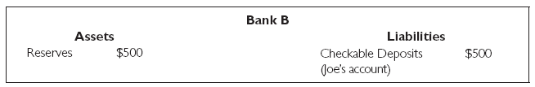
Money Supply Creation Process V
The money supply is now $10,500
Jill now takes the $500 loan from bank A (in the form of a new checkable deposit) and spends it. Specifically, she writes a check for $500 to Joe for the materials she buys from him. Joe then takes the $500 (he received from Jill) and deposits the full amount into his checking account at bank B. The situation for bank B looks like this:
Click to return to “In this Lesson”
© 2014 Cengage Learning. All Rights Reserved. May not be copied, scanned, or duplicated, in whole or in part, except for use as permitted in a license distributed with certain product , service, or otherwise on password-protected website for classroom use

Slide 25
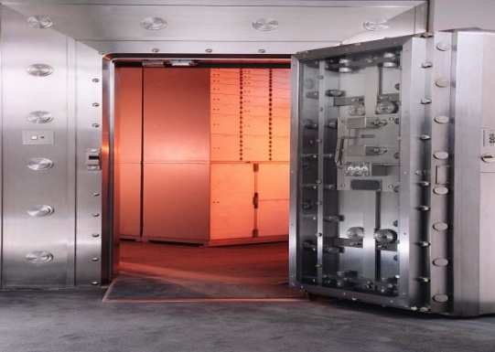
Money Supply Creation Process VI
Bank B now has $500 that it didn’t have previously, increasing its reserves (assets) by $500 and liabilities (checkable deposits) by $500. Bank B’s balance sheet shows $500 in reserves and $500 in checkable deposits.
But if the required reserve ratio is 10 percent, bank B is required to hold only $50 in reserves. Bank B has $450 in excess reserves.
Bank B uses the entire $450 in excess reserves to create a loan of $450 for Jamal in the form of a checkable deposit. In other words, bank B creates a new checkable deposit of $450.
And the process continues
See the next slide
Click to return to “In this Lesson”
© 2014 Cengage Learning. All Rights Reserved. May not be copied, scanned, or duplicated, in whole or in part, except for use as permitted in a license distributed with certain product , service, or otherwise on password-protected website for classroom use

Slide 26
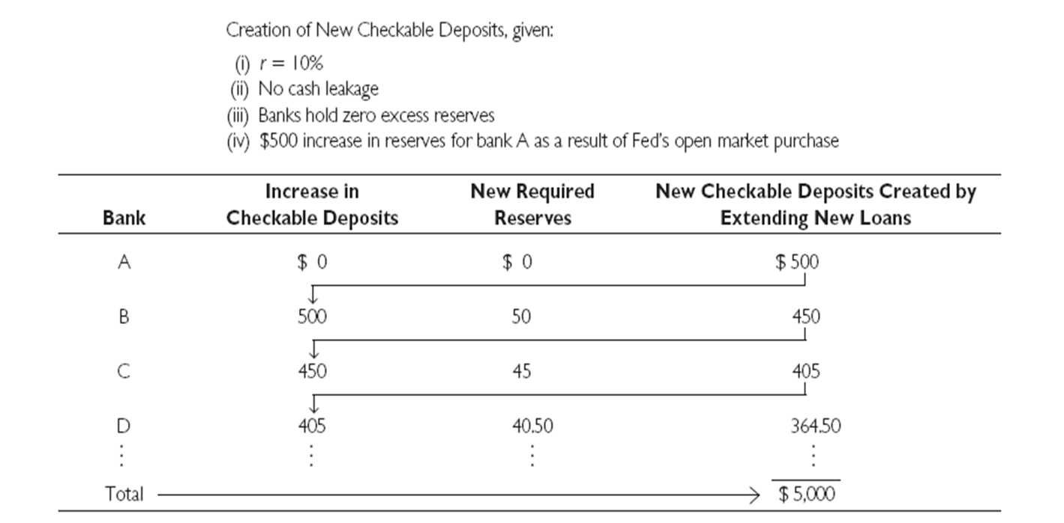
The Banking System Creates
Checkable Deposits (Money)
Click to return to “In this Lesson”
© 2014 Cengage Learning. All Rights Reserved. May not be copied, scanned, or duplicated, in whole or in part, except for use as permitted in a license distributed with certain product , service, or otherwise on password-protected website for classroom use

Slide 27
Money Supply Contraction Process I
For now we are going to assume that the entire $10,000 in checkable deposits is held in one bank: bank A.
We will also assume that the required reserve ratio is 10 percent and that bank A is currently holding $1,000 in required reserves and no excess reserves. Here is the relevant part of the balance sheet for bank A:
Click to return to “In this Lesson”
© 2014 Cengage Learning. All Rights Reserved. May not be copied, scanned, or duplicated, in whole or in part, except for use as permitted in a license distributed with certain product , service, or otherwise on password-protected website for classroom use

Slide 28
Money Supply Contraction Process II
The Fed conducts an open market sale, which is a type of open market operation; specifically, it sells government securities to a bank.
In this example it sells $400 worth of government securities to bank A. The Fed turns over the government securities to the Bank A, and, in return, the Fed receives $400 from Bank A.
Click to return to “In this Lesson”
© 2014 Cengage Learning. All Rights Reserved. May not be copied, scanned, or duplicated, in whole or in part, except for use as permitted in a license distributed with certain product , service, or otherwise on password-protected website for classroom use

Slide 29
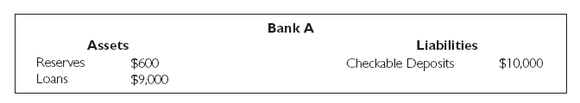
Money Supply Contraction Process III
Reserves for bank A have gone from $1,000 to $600. Given that checkable deposits are $10,000, bank A is reserve deficient. If the required reserve ratio is 10 percent, bank A is required to hold $1,000 in reserves ($10,000 0.10) . But after the open market sale, bank A is holding only $600 in reserves, and so it is reserve deficient by $400.
Click to return to “In this Lesson”
© 2014 Cengage Learning. All Rights Reserved. May not be copied, scanned, or duplicated, in whole or in part, except for use as permitted in a license distributed with certain product , service, or otherwise on password-protected website for classroom use

Slide 30
Money Supply Contraction Process IV
When a bank is reserve deficient*, it can do a number of things: It can (1) try to get a loan from another bank; (2) try to get a loan from the Fed; or (3) apply some of its loan repayments to the reserve deficiency position. In our example, it chooses option 3. On the day bank A becomes reserve deficient, Harry walks into the bank and pays back the $400 loan he took out months ago.
Because the bank is reserve deficient, it keeps the $400 as reserves. As a result, checkable deposits decline by $400; so the money supply declines by $400 to $9,600. from $10,000.
* The situation that exists when a bank holds fewer reserves than specified by the required reserve ratio.
Click to return to “In this Lesson”
© 2014 Cengage Learning. All Rights Reserved. May not be copied, scanned, or duplicated, in whole or in part, except for use as permitted in a license distributed with certain product , service, or otherwise on password-protected website for classroom use

Slide 31
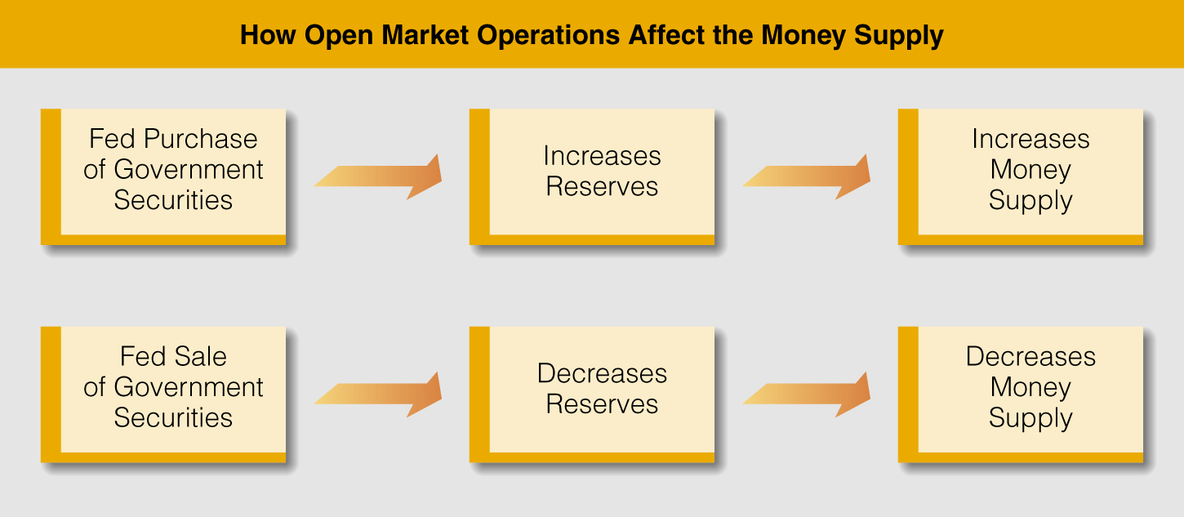
Open Market Operations
Click to return to “In this Lesson”
© 2014 Cengage Learning. All Rights Reserved. May not be copied, scanned, or duplicated, in whole or in part, except for use as permitted in a license distributed with certain product , service, or otherwise on password-protected website for classroom use

Slide 32
Required Reserve Ratio
The Fed rule that specifies the amount of reserves a bank must hold to back up deposits.
Maximum change in checkable deposits = (1/r) x ΔR (r=required reserve ratio; R = reserves)
↑ r → ↓ in checkable deposits
↓ r → ↑ in checkable deposits
Click to return to “In this Lesson”
© 2014 Cengage Learning. All Rights Reserved. May not be copied, scanned, or duplicated, in whole or in part, except for use as permitted in a license distributed with certain product , service, or otherwise on password-protected website for classroom use

Slide 33

Why Banks Borrow Reserves
To increase loan making ability
To meet required reserve requirements
Click to return to “In this Lesson”
© 2014 Cengage Learning. All Rights Reserved. May not be copied, scanned, or duplicated, in whole or in part, except for use as permitted in a license distributed with certain product , service, or otherwise on password-protected website for classroom use

Slide 34
The Discount Window and the Federal Funds Market
Discount Loan - A loan the Fed makes to a commercial bank.
Discount Rate - The interest rate the Fed charges depository institutions that borrow reserves from it; the interest rate charged on a discount loan.
Federal Funds Rate - The interest rate in the federal funds market; the interest rate banks charge one another to borrow reserves.
Federal Funds Market - A market where banks lend reserves to one another, usually for short periods.
Click to return to “In this Lesson”
© 2014 Cengage Learning. All Rights Reserved. May not be copied, scanned, or duplicated, in whole or in part, except for use as permitted in a license distributed with certain product , service, or otherwise on password-protected website for classroom use

Slide 35
The Discount Window
Fed sets discount rate below federal funds rate →
Banks borrow from Fed →
Banks have more reserves →
Banks may make more loans and checkable deposits →
Money supply rises
Click to return to “In this Lesson”
© 2014 Cengage Learning. All Rights Reserved. May not be copied, scanned, or duplicated, in whole or in part, except for use as permitted in a license distributed with certain product , service, or otherwise on password-protected website for classroom use

Slide 36

Federal Funds Rate Target
Normally, however, if the Fed wants to change the money supply, it takes two measures: (1) It sets a federal funds rate target* and then (2) uses open market operations to change the federal funds rate so as to “hit” the target.
* The interest rate that the Fed wants the federal funds market rate to be.
Click to return to “In this Lesson”
© 2014 Cengage Learning. All Rights Reserved. May not be copied, scanned, or duplicated, in whole or in part, except for use as permitted in a license distributed with certain product , service, or otherwise on password-protected website for classroom use

Slide 37
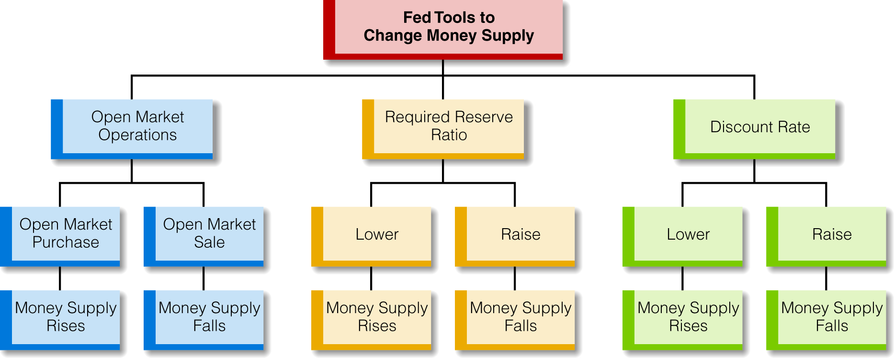
Fed Monetary Tools and Their Effects on the Money Supply
Click to return to “In this Lesson”
© 2014 Cengage Learning. All Rights Reserved. May not be copied, scanned, or duplicated, in whole or in part, except for use as permitted in a license distributed with certain product , service, or otherwise on password-protected website for classroom use

Slide 38

Term Auction Facility (TAF) Program
In this program, instead of banks asking for a specific dollar loan (as in a discount loan), the Fed first identifies the total amount of credit it wants to extend (for example, $20 billion). Then it allows banks to bid on the funds. The bidding process determines the TAF rate (interest rate) for the loans.
Click to return to “In this Lesson”
© 2014 Cengage Learning. All Rights Reserved. May not be copied, scanned, or duplicated, in whole or in part, except for use as permitted in a license distributed with certain product , service, or otherwise on password-protected website for classroom use

Slide 39
Recent Fed Actions During the Financial Crisis
EXTENDING THE LENDER-OF-LAST-RESORT FUNCTION BEYOND BANKS
As the lender of last resort for banks, the Fed ensures that banks can obtain the funds they need. If a bank has financial problems, it can seek funds from the Fed. During the financial crisis, the Fed extended its lender-of-last-resort function to institutions other than banks.
BUYING SECURITIES FROM INSTITUTIONS OTHER THAN BANK
During normal economic times, the Fed buys Treasury securities from banks if it wants to increase reserves in the banking system to raise the money supply. During the financial crisis, the Fed not only bought securities from nonbank institutions, but often bought securities that were not Treasury issues. Often they were mortgage-backed securities that institutions owned that were declining in value.
Click to return to “In this Lesson”
© 2014 Cengage Learning. All Rights Reserved. May not be copied, scanned, or duplicated, in whole or in part, except for use as permitted in a license distributed with certain product , service, or otherwise on password-protected website for classroom use

Slide 40
Free Banking
In today’s world there is a central bank – The Fed. And as we know the Fed controls the money supply. But suppose there were no Fed. Who or what would then control the money supply. One option is free banking.
Under free banking monetary arrangement each individual bank would issue its own currency (their own bank notes) based on, perhaps, commodity reserves. The money supply would be determined by market forces; specifically the money supply would adjust (up or down) in response to changes in the public’s demand for money.
Click to return to “In this Lesson”
© 2014 Cengage Learning. All Rights Reserved. May not be copied, scanned, or duplicated, in whole or in part, except for use as permitted in a license distributed with certain product , service, or otherwise on password-protected website for classroom use

Slide 41
Self-test
How does the money supply change as a result of (a) an increase in the discount rate, (b) an open market purchase, (c) an increase in the required reserve ratio?
a. The money supply falls.
b. The money supply rises.
c. The money supply falls.
Click to return to “In this Lesson”
© 2014 Cengage Learning. All Rights Reserved. May not be copied, scanned, or duplicated, in whole or in part, except for use as permitted in a license distributed with certain product , service, or otherwise on password-protected website for classroom use

Slide 42
Self-test
2. What is the difference between the federal funds rate and the discount rate?
The federal funds rate is the interest rate that one bank charges another bank for a loan. The discount rate is the interest rate that the Fed charges a bank for a loan.
Click to return to “In this Lesson”
© 2014 Cengage Learning. All Rights Reserved. May not be copied, scanned, or duplicated, in whole or in part, except for use as permitted in a license distributed with certain product , service, or otherwise on password-protected website for classroom use

Slide 43
Self-Test
3 . If bank A borrows $10 million from bank B, what happens to the reserves in bank A? What happens in the banking system?
Reserves in bank A rise; reserves in the banking system remain the same (bank B loses the reserves that bank A borrowed).
Click to return to “In this Lesson”
© 2014 Cengage Learning. All Rights Reserved. May not be copied, scanned, or duplicated, in whole or in part, except for use as permitted in a license distributed with certain product , service, or otherwise on password-protected website for classroom use

Slide 44
Self-test
4. If bank A borrows $10 million from the Fed, what happens to the reserves in bank A? in the banking system?
Reserves in bank A rise; reserves in the banking system rise because there is no offset in reserves for any other bank.
Click to return to “In this Lesson”
© 2014 Cengage Learning. All Rights Reserved. May not be copied, scanned, or duplicated, in whole or in part, except for use as permitted in a license distributed with certain product , service, or otherwise on password-protected website for classroom use

Slide 45

Wall Street Journal
The Wall Street Journal is a is a rich source of information which provides real life examples of micro- and macro economic activities. Check today’s issue to see the most current news.
http://www.wsj.com
Click to return to “In this Lesson”
© 2014 Cengage Learning. All Rights Reserved. May not be copied, scanned, or duplicated, in whole or in part, except for use as permitted in a license distributed with certain product , service, or otherwise on password-protected website for classroom use

